Slide 1
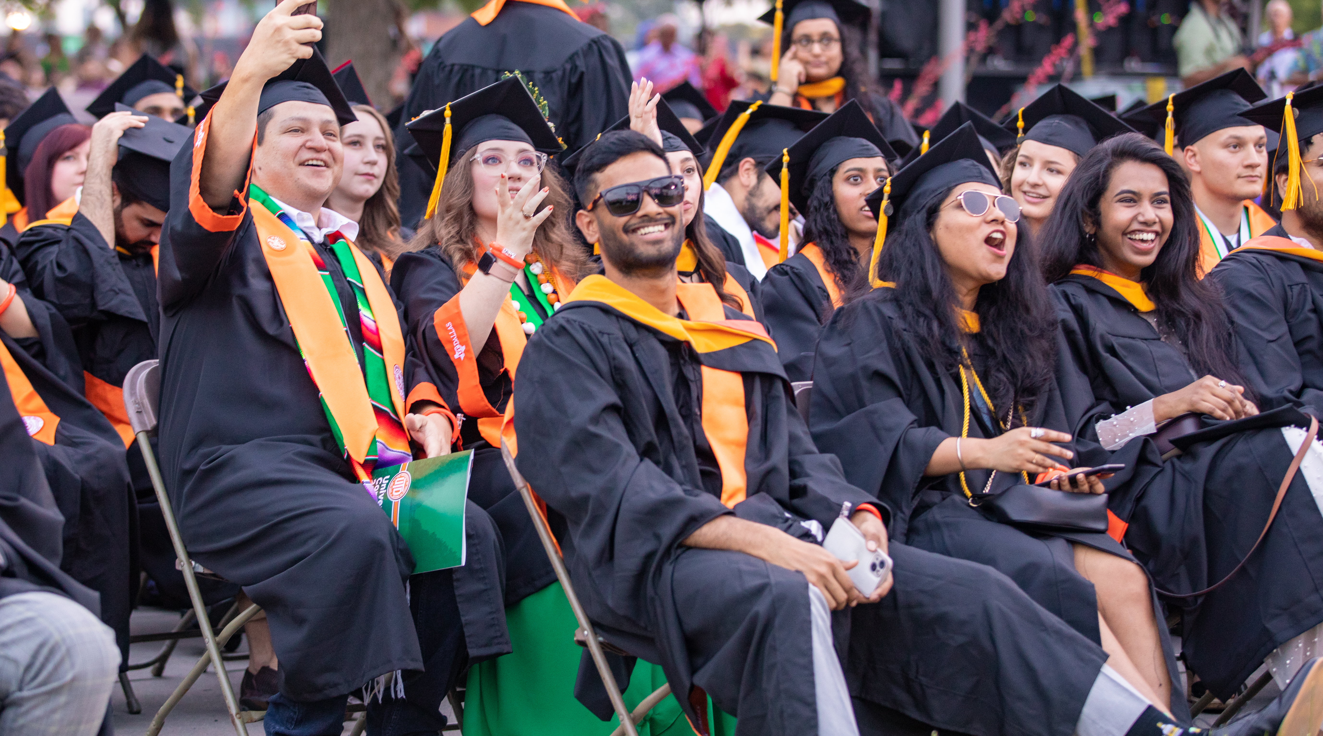

Doctoral Hooding Ceremony
Spring 2025 Commencement
Friday, May 16 | 1 p.m.

Slide 2
University Commencement
Spring 2025 Commencement
Friday, May 16 | 7:30 p.m.

Slide 3
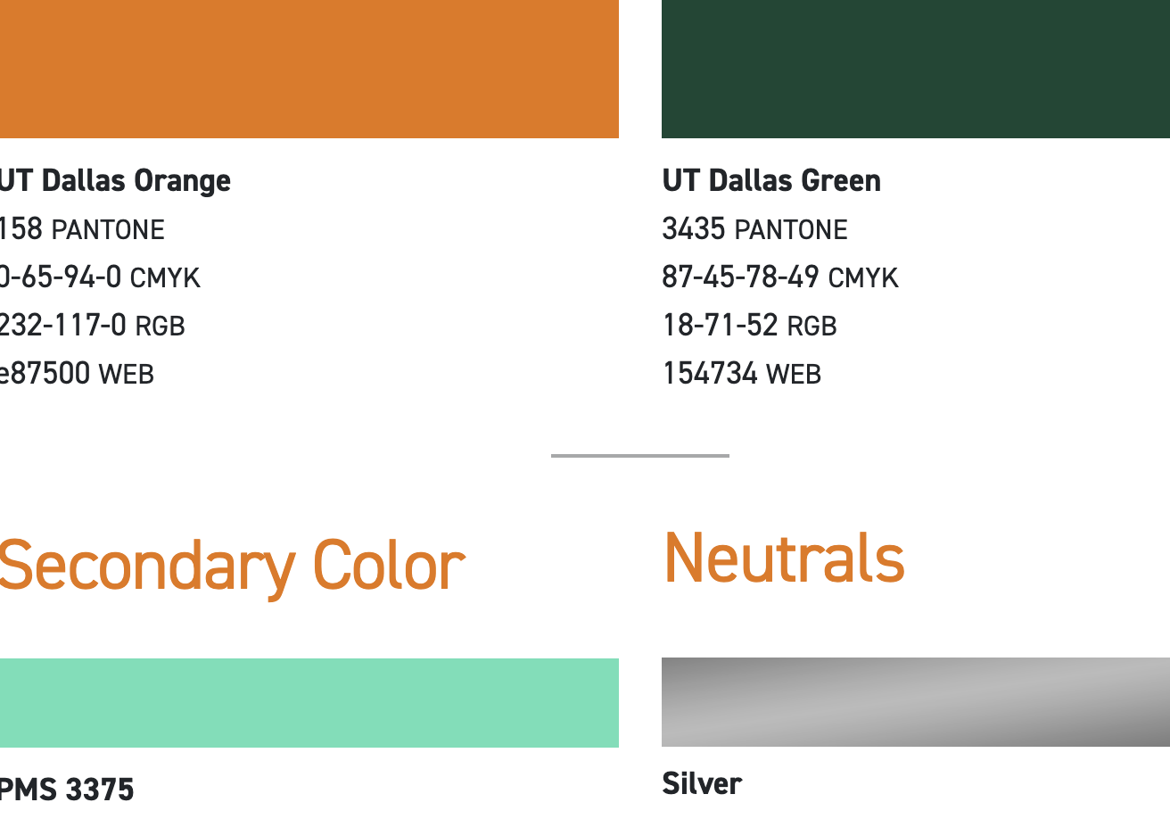
School of Natural Sciences and Mathematics
Spring 2025 Commencement
Monday, May 19 | 9 a.m.

Slide 4
School of Behavioral and Brain Sciences
Spring 2025 Commencement
Monday, May 19 | 11:30 a.m.

Slide 5
Naveen Jindal School of Management
Ceremony 1
Spring 2025 Commencement
Monday, May 19 | 2 p.m.

Slide 6
Naveen Jindal School of Management
Ceremony 2
Spring 2025 Commencement
Monday, May 19 | 4:30 p.m.

Slide 7
Naveen Jindal School of Management
Ceremony 3
Spring 2025 Commencement
Tuesday, May 20 | 9 a.m.

Slide 8
School of Economic, Political and Policy Sciences
Spring 2025 Commencement
Wednesday, May 20 | 10:30 a.m.

Slide 9
Naveen Jindal School of Management
Ceremony 4
Spring 2025 Commencement
Tuesday, May 20 | 11:30 a.m.

Slide 10
School of
Interdisciplinary Studies
Spring 2025 Commencement
Wednesday, May 20 | 1 p.m.

Slide 11
Naveen Jindal School of Management
Ceremony 5
Spring 2025 Commencement
Tuesday, May 20 | 2 p.m.

Slide 12
Harry W. Bass Jr. School of Arts, Humanities, and Technology
Spring 2025 Commencement
Tuesday, May 20 | 4:30 p.m.

Slide 13
Erik Jonsson School of Engineering and Computer Science
Ceremony 1
Spring 2025 Commencement
Wednesday, May 21 | 9 a.m.

Slide 14
Erik Jonsson School of Engineering and Computer Science
Ceremony 2
Spring 2025 Commencement
Wednesday, May 21 | 11:30 a.m.

Slide 15
Erik Jonsson School of Engineering and Computer Science
Ceremony 3
Spring 2025 Commencement
Wednesday, May 21 | 2 p.m.

